Slide 1

Flight Price Prediction
Harshika Mahesh

Slide 2
OVERVIEW
1. Data Cleaning
2. Exploratory Data Analysis
3. Data Pre-processing
4. Model Building
5. Model Evaluation
6. Selecting the best model

Slide 3
Data Cleaning
Airline ticket can be bought up to 1 year advance Price Changes from day to day
Construct and train a general classifier so that it can distinguish between expensive and cheap tickets
Determine which factor have the greatest impact on price by analyzing the trained classifier

Slide 4
Exploratory Data Analysis
Lots of Fields:
“Buy Date : when was this price current?
“Fly Date : when does the flight leave?
Price and currency
Cabin class
Booking class
The “Airline” : the airline selling the ticket

Slide 5
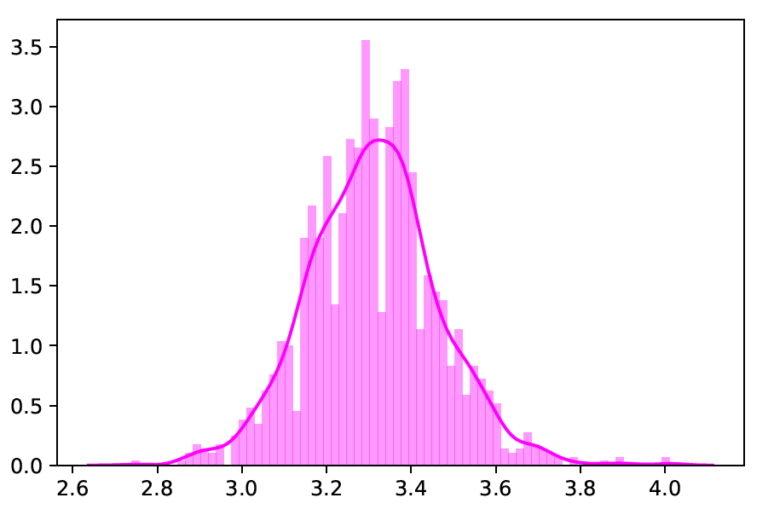

Slide 6
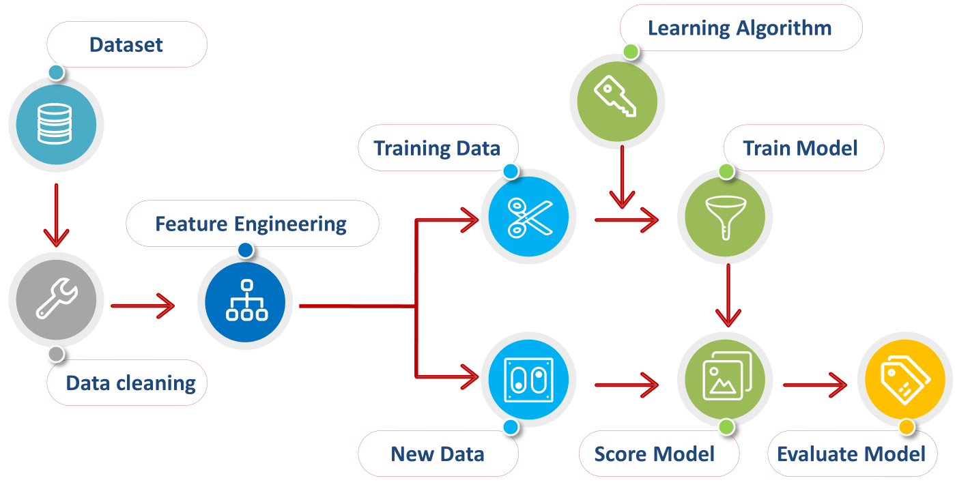
Data Preprocessing
Preprocessing of Data

Slide 7
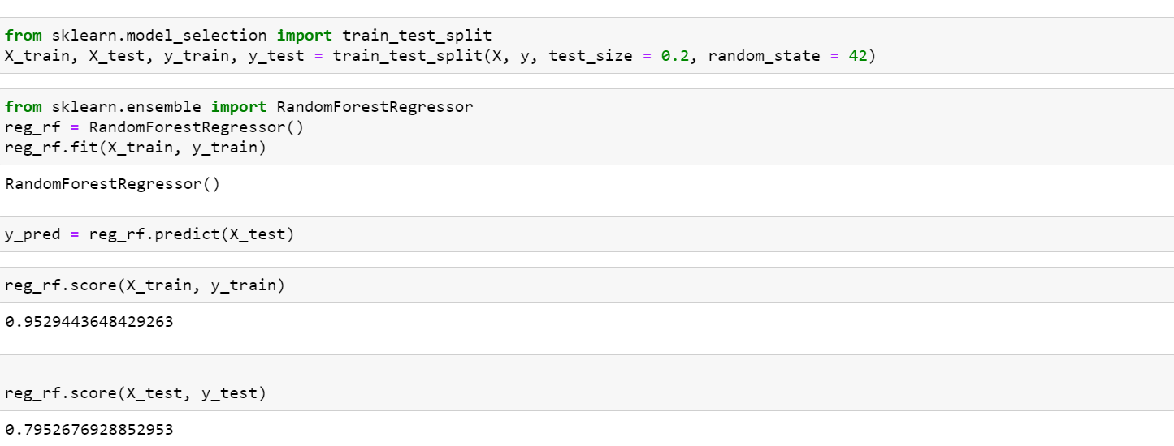
Model Building

Slide 8
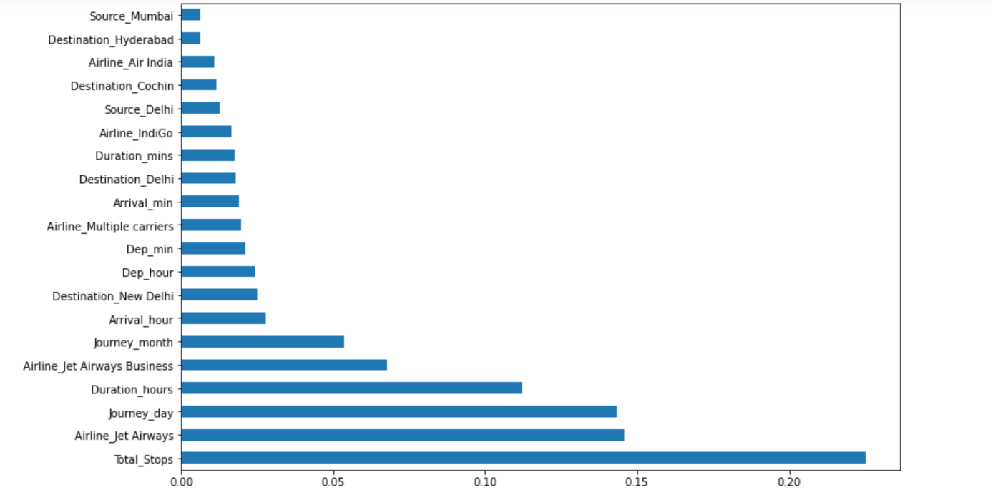

Slide 9
MACHINE LEARNING ALGORITHM
To develop the model for the flight price prediction, many conventional machine learning algorithms are evaluated. They are as follows: Linear regression, Decision tree[8], Random Forest Algorithm[9], K-Nearest neighbors[7], Multilayer Perceptron[10], Support Vector Machine (SVM) [11]and Gradient Boosting. All these models are implemented in the scikit learn. To evaluate the performance of this model, certain parameters are considered. They are as follows: R-squared value, Mean Absolute Error (MAE) and Mean Squared Error (MSE).

Slide 10
ML algorithms | R-squared | MAE | MSE
Random forest | 0.67 | 0.08 | 0.04
Multilayer Perceptron | 0.65 | 0.09 | 0.04
Gradient Boosting | 0.47 | 0.13 | 0.06
Decision tree | 0.45 | 0.09 | 0.06
K-nearest neighbour | 0.38 | 0.14 | 0.07
SVM | 0.19 | 0.15 | 0.08
AdaBoost | -0.12 | 0.21 | 0.11

